Slide 1

Project Closure -Hybrid Campus by OEU
Presented by Group 203:
Yidie Hu (Olivia)
Rui Qin (Allen)
Yueshi Liu (Evelyn)

Slide 2
Overview
Project objectives
Summary of project results & benefits of the system
Project assessment
Lessons learned

Slide 3
1. Project Objectives Main goals – OEU’s strategic goals
To expand the current customer base of students
To improve cooperation between campuses
product offerings
resources
knowledge
research
To utilise technology
improved product
lower costs
competitive advantage

Slide 4
1. Project Objectives triple constraints
Scope
1 studio & 10 study centres
System development (videoconferencing & LMS)
Testing
Training
Time: 1 year
Cost: $1.5 million
Marketing

Slide 5
1. Project Objectives To achieve the goals
Month 5
Design and develop the videoconferencing system and learning management system (LMS) by the end of month 5.
Month 6
Establish a studio by the end of month 6.
Month 11
Establish and roll out 10 study centres by the end of month 11 (2 centres per month).
Month 12
Complete training during month 12.

Slide 6

2. Project summary study centres
10 study centres over the world
2 in Australia
1 in France
2 in China
2 in UK
1 in Brazil
2 in Japan
(Molinsky, 2022)

Slide 7
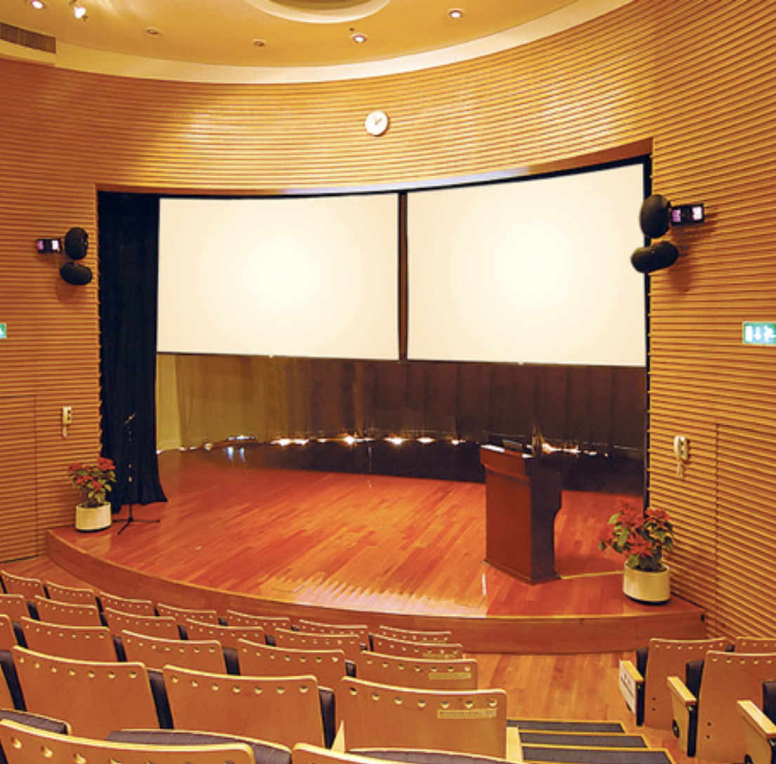
2. Project summary study centres
Study centre
-videoconferencing venue
50 seats
2 large television screens
1 camera
6 speakers
1 microphone
(Extron, 2022)

Slide 8
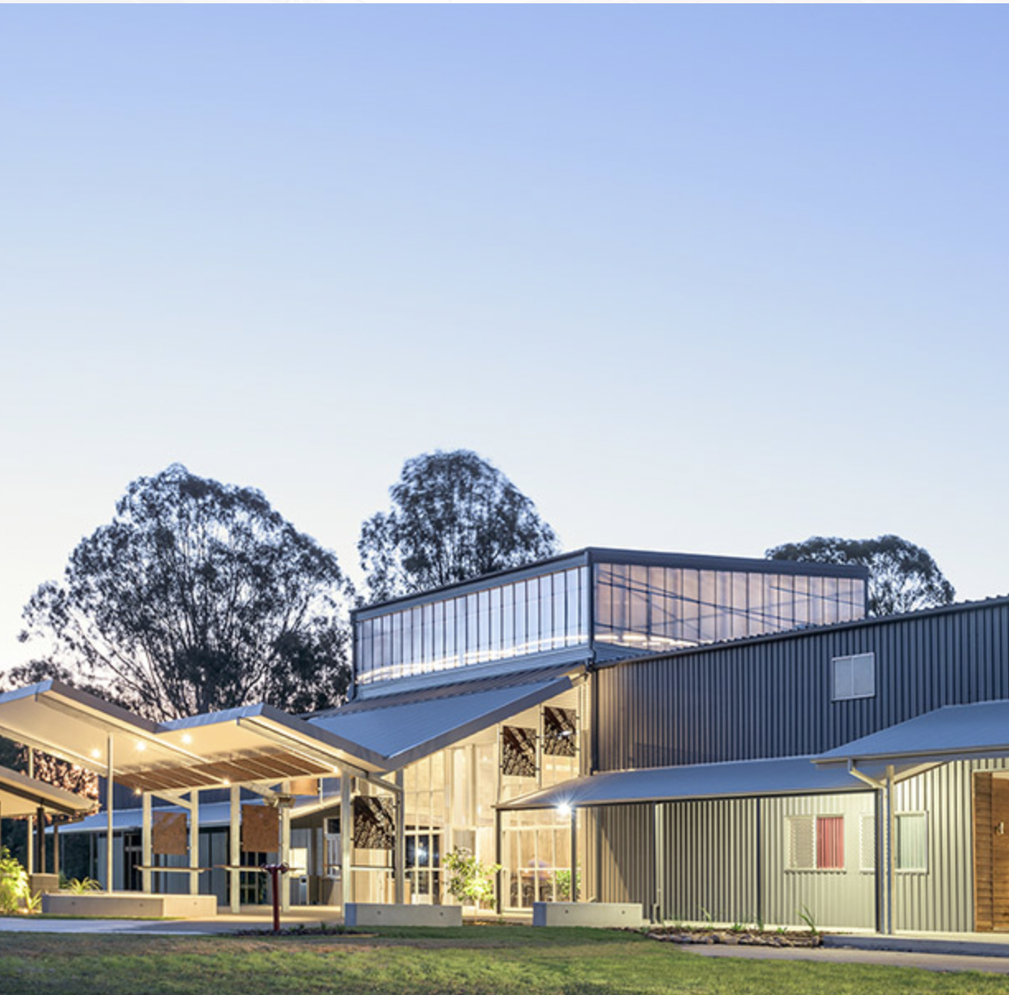
2. Project summary study centres
Study centres:
Highly competitive:
The first to provide the qualifications in the communities
Reduced cost:
rent community buildings
Lower tuition fees:
30% less than the physical campuses
up to 500 students per lecture
Economy of scale:
(Smith Architects, 2015)

Slide 9
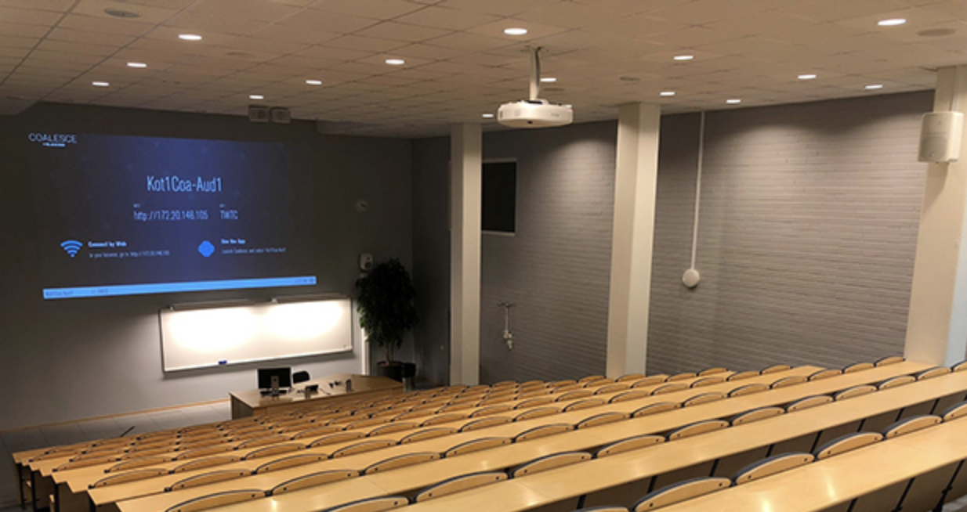
2. Project summary Videoconferencing system
Videoconferencing system
-two-way classes
Studio end
Lecturer delivers classes
Live footage of every study centre
Study centre end
Up to 50 students per class
Ask questions and interact with lecturer
(Campos, 2019)

Slide 10
2. Project summary Videoconferencing system
Videoconferencing system
ISO9000 standards
High resolution:
video: Full HD 1080p ~ 4K Ultra HD
Audio: 24 bit/192kHz
“six nines” availability
2.63s downtime per month
(Campos, 2019)

Slide 11

2. Project summary support
Learning management system (LMS):
Online self-learning
In-semester assessments
Internet:
High speed: 20~25Mbps
Minimal latency: <50ms
Strong signal: >-50dBm
(GCF Global, 2021)

Slide 12

2. Project summary benefits
For students
more accessible
more affordable
maximised learning experience
For OEU
campus growth
reduced costs
healthy profits
(Katy News, 2020)

Slide 13

3. Project assessment -what we have done well
Popular among students
Study centres: 200~300 students per centre
High student satisfaction rate
95% satisfaction
Sponsor satisfied – Board of Directors of OEU
100% satisfaction
(Carlson, 2020)

Slide 14
3. Project assessment -triple constraints
Meet scope goals
Meet time goals
12 months
Slight cost overrun
actual total cost: $1.53 million

Slide 15
3. Project assessment -what we haven’t done well
Over budget ($30000)

Slide 16
3. Project assessment -prospective benefit

Slide 17
4. Lessons learned

Slide 18
Conclusion

Slide 19
Picture references
Campos, G. (2019). Collaborative learning with a reduced technical burden. Retrieved from https://www.avinteractive.com/news/collaboration/fifty-room-collaboration-system-installation-cuts-support-requests-30-01-2019/
Carlson, J. (2020). How to make your resume stand out with strong achievements. Retrieved from https://savviest.com/blog/how-to-make-your-resume-stand-out-with-strong-achievements/
Extron. (2022). Lecture hall system. Retrieved from https://www.extron.com/article/lecturehallsystem
GCF Global. (2021). Getting started with the Internet. Retrieved from https://edu.gcfglobal.org/en/computerbasics/getting-started-with-the-internet/1/
Katy News. (2020). 10 expected benefits of education. Retrieved from https://thekatynews.com/2020/01/24/10-expected-benefits-of-education/
Molinsky, A. (2022). The same manager’s guide to managing a team that’s spread out all over the world. Retrieved from https://www.inc.com/andy-molinsky/manage-a-global-virtual-team-5-ways-to-make-sure-everyone-gets-along-and-gets-stuff-done.html
Smith Architects. (2015). Ipswich community buildings. Retrieved from http://www.smitharchitects.com.au/ipswich-community-buildings

